Slide 1

Diversity in Tech Neyda Morales, Carlos Ruiz, Paris Lee, Daniel Purrier June 10, 2024

Slide 2
Agenda
Thesis
Introducing our Data
Research Questions
Linear & Statistical Modeling
Bias and Limitations
Future Work
Call to Action
Works Cited
Q&A

Slide 3

Thesis: Is global diversity reflected in Tech workforce? Findings: As the workforce is constantly changing, the analysis of this dataset allowed us to explore whether global diversity is reflected in tech workforces. Companies at large have seen more of a push for diversity, equity, and inclusion in the workplace. We found that over a 5-year period the male population was about twice the size of the female population. The Latino and Black groups remained consistent at under 10% while the Asian group maintained itself at 20% and saw greater growth. Additionally, we will discuss the limitations to our dataset and future work that can enhance this study.

Slide 4
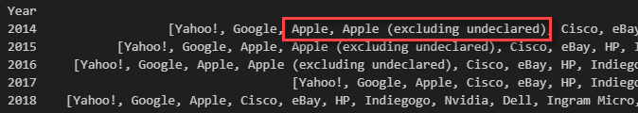
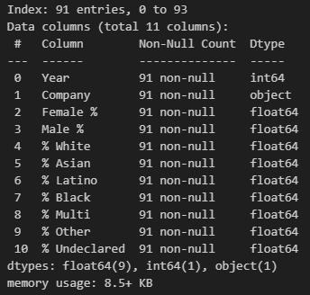
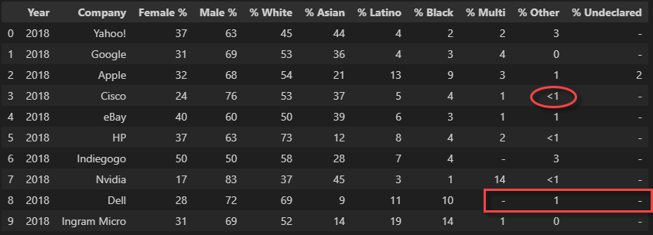
Introducing our Data
Data Cleaning Overview:
Removed duplicate of Apple, Rounded down to 0% for anything that was <1, Converted all dashes to 0%, Converted all percentages to floats

Slide 5
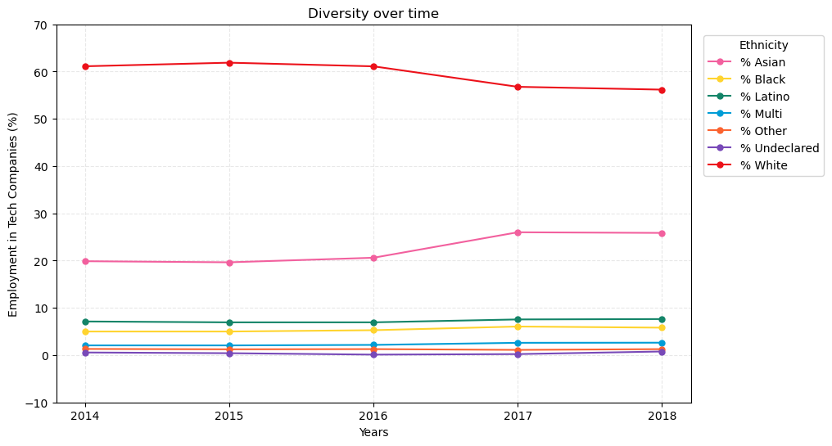
Research Question 1
Has diversity in tech companies increased over time?

Slide 6

What is the percentage of Males vs Females in the tech workplace?
Research Question 2

Slide 7
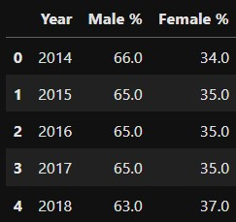
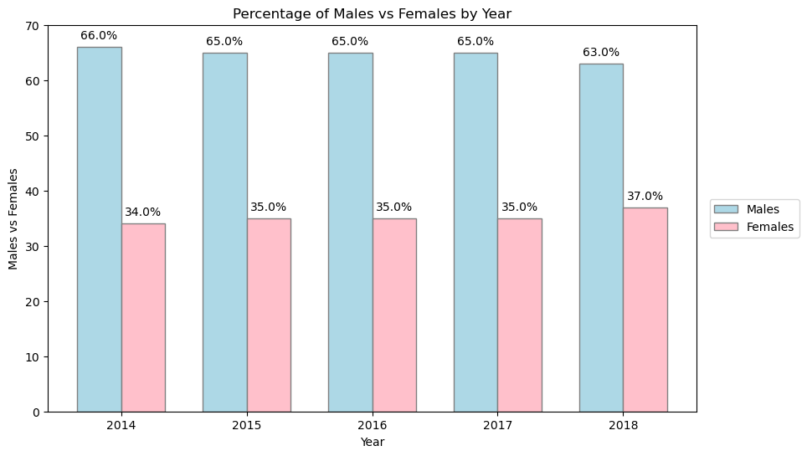
Males vs Females 2014-2018

Slide 8
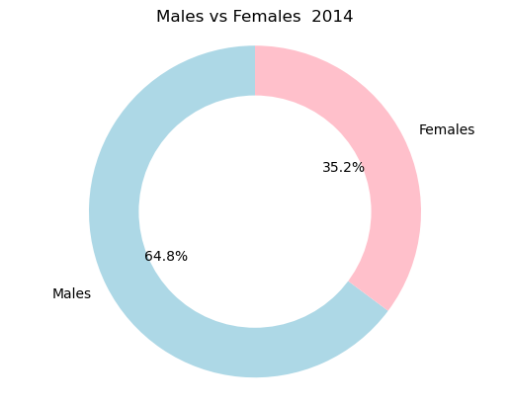
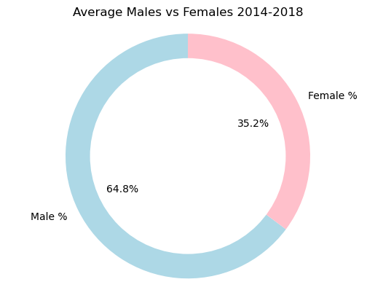
Deeper Dive

Slide 9
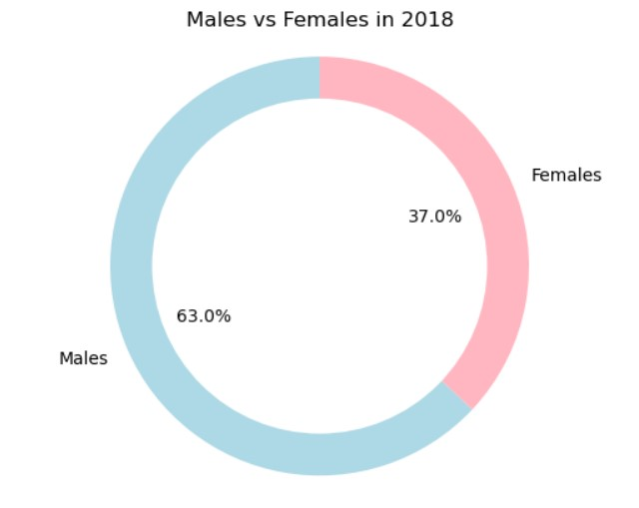
Final Year

Slide 10
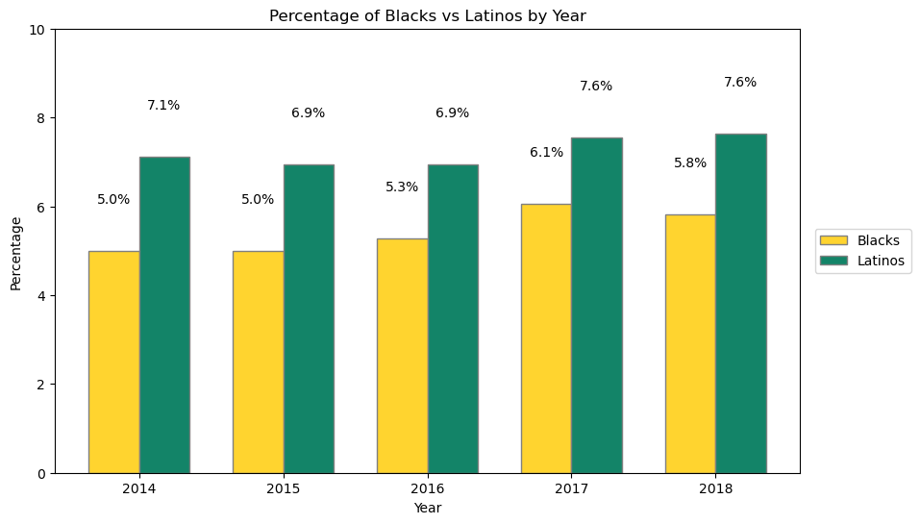
Research Question 3
How do Black people and Latino people compare over time?

Slide 11

Linear & Statistical Modeling

Slide 12
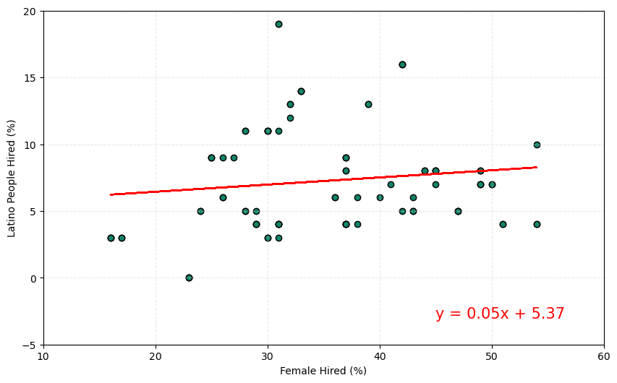
Regression
Are companies that hire more Women more likely to hire Latino people?
The r-value is: 0.12619415936237158

Slide 13
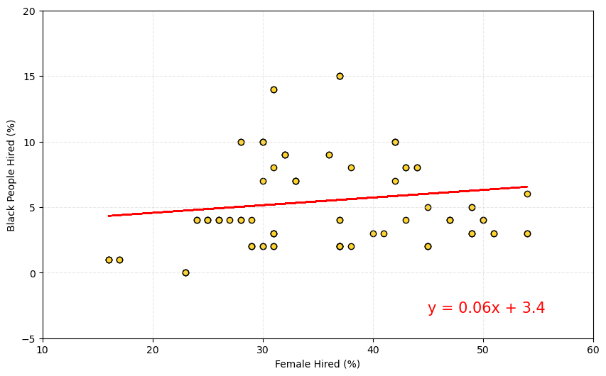
Regression
Are companies that hire more Women more likely to hire Black people?
The r-value is: 0.12619415936237158

Slide 14
Statistical Testing
Gender - Hypothesis
Null: There is no difference between Males vs Females working in Tech Companies.
Alternative: There is a difference between Males vs Females working in Tech Companies.
Diversity - Hypothesis
Null: There is no difference in the averages between each diversity group.
Alternative: There is at least one difference in the averages between each diversity group.

Slide 15
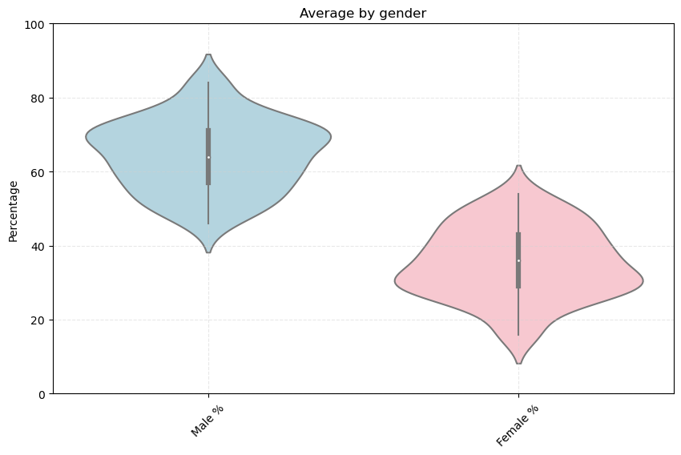
Gender
We accept the alternative hypothesis – there is a significant difference between males and females across tech companies.
TtestResult
(statistic=20.573574726611028, pvalue=3.78484545338512e-49, df=179.9993887209176)

Slide 16
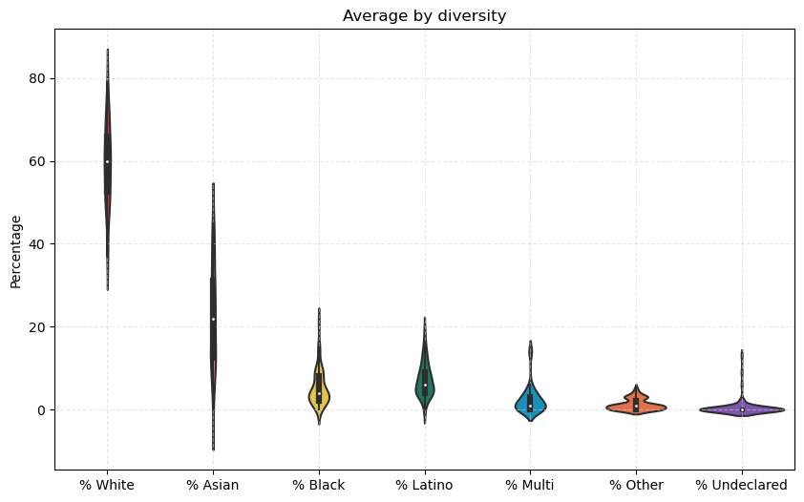
Diversity
We accept the alternative hypothesis – there is at least one diversity group with differences in the averages.
FonewayResult
(statistic=985.8325475532455, pvalue=2.47133054e-316)

Slide 17

Bias and Limitations
Small list of companies
Company size not included
Recent years not included
Raw Numbers not included (only percentages)
Intersectional data not included (ex: Latino female, Black Male)
Values that were Undeclared

Slide 18


Future Work
Pull data that spans a longer period
Incorporate company size
Ensure that the data includes gender and race for each employee
Obtain data that is more gender inclusive (gender diversity)
Capture employee satisfaction data: are minority employees happy in their respective companies?

Slide 19



Call to Action
Tackle unconscious bias within the workplace and on individual teams
Introduce tech into more schools
workshops, camps, clubs, and after school programs centered around technology

Slide 20
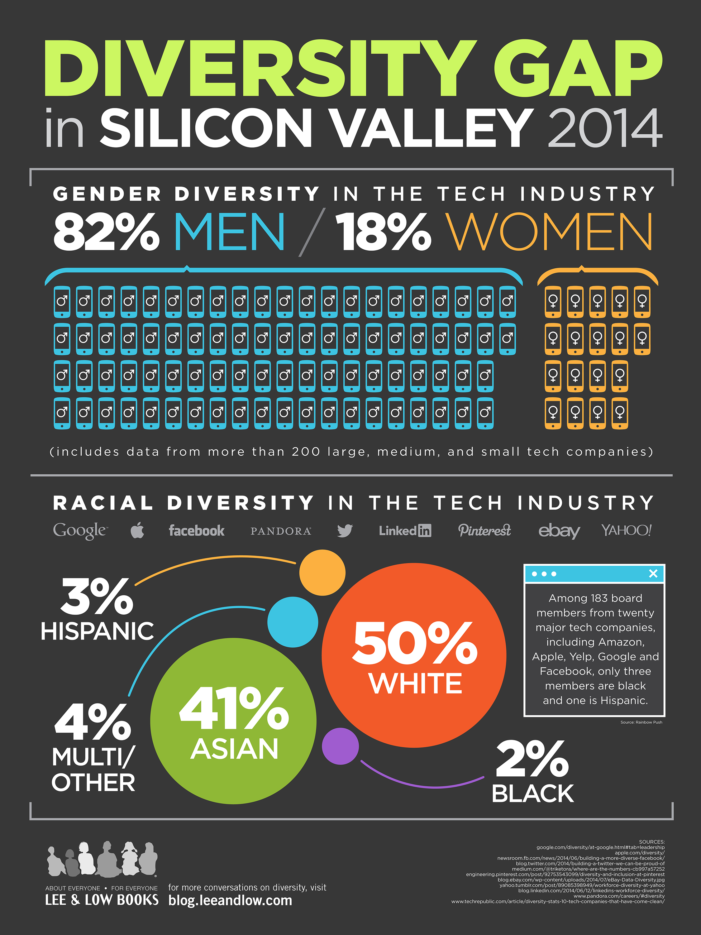
Works Cited
Jainaru. "Diversity in Tech Companies." Kaggle, www.kaggle.com/datasets/jainaru/diversity-in-tech-companies/data. Accessed 10 June 2024.
"The Diversity Gap in Silicon Valley." Lee & Low Books Blog, 12 Mar. 2015, blog.leeandlow.com/2015/03/12/the-diversity-gap-in-silicon-valley/. Accessed 10 June 2024.
"Set Color for Each Violin in Violin Plot." Stack Overflow, stackoverflow.com/questions/34058188/set-color-for-each-violin-in-violin-plot. Accessed 10 June 2024.
"The Gender Gap in Tech: Let’s Talk About It." Ironhack Blog, www.ironhack.com/gb/blog/the-gender-gap-in-tech-let-s-talk-about-it. Accessed 10 June 2024.
Lardinois, Frederic. "Black, Latino People Are Being Left Out of the Tech Workforce." GovTech, www.govtech.com/workforce/black-latino-people-are-being-left-out-of-the-tech-workforce.html. Accessed 10 June 2024.

Slide 21
Findings: As the workforce is constantly changing, the analysis of this dataset allowed us to explore whether global diversity is reflected in tech workforces. Companies at large have seen more of a push for diversity, equity, and inclusion in the workplace. We found that over a 5-year period the male population was about twice the size of the female population. The Latino and Black groups remained consistent at under 10% while the Asian group maintained itself at 20% and saw greater growth. Additionally, we will discuss the limitations to our dataset and future work that can enhance this study.

Slide 22

Thank you
Questions?

Slide 23
Diversity ttest
White vs Asian: TtestResult(statistic=22.426127199064165, pvalue=3.4974324485005776e-53, df=173.78741107942048)
White vs Black: TtestResult(statistic=47.45100949423269, pvalue=6.374334017920352e-81, df=122.98495278778121)
White vs Latino: TtestResult(statistic=46.29135565132039, pvalue=4.13282193180125e-78, df=119.3735241720709)
White vs Multi: TtestResult(statistic=51.99438750290772, pvalue=4.870119400677852e-79, df=109.537654889487)
White vs Other: TtestResult(statistic=55.316345330041564, pvalue=3.910652332452989e-73, df=93.31475419432466)
White vs Undeclared: TtestResult(statistic=55.69860802269435, pvalue=7.557267383459079e-75, df=95.9104106591678)
Asian vs Black: TtestResult(statistic=12.852924987195221, pvalue=7.644253536628321e-24, df=112.92177336927801)
Asian vs Latino: TtestResult(statistic=11.581759018419703, pvalue=8.827328477772503e-21, df=110.3300092458146)
Asian vs Multi: TtestResult(statistic=15.577446894105972, pvalue=6.992841235175281e-29, df=103.40989499464588)
Asian vs Other: TtestResult(statistic=16.909733828894062, pvalue=5.166342130749162e-30, df=92.26101951932218)
Asian vs Undeclared: TtestResult(statistic=17.467632811843643, pvalue=2.8276886801936257e-31, df=94.03313383302206)
Black vs Latino: TtestResult(statistic=-2.9021422691618346, pvalue=0.004171105579260181, df=179.31680824799332)
Black vs Multi: TtestResult(statistic=5.509231046627633, pvalue=1.3317013546634914e-07, df=168.02727152668047)
Black vs Other: TtestResult(statistic=8.904425131520638, pvalue=1.4956780083145585e-14, df=107.30242991242221)
Black vs Undeclared: TtestResult(statistic=10.270102429424778, pvalue=3.7853392676111054e-18, df=120.25779691951077)
Latino vs Multi: TtestResult(statistic=9.017914867341968, pvalue=3.608912970795619e-16, df=172.49074872237733)
Latino vs Other: TtestResult(statistic=13.439520313134684, pvalue=6.477281620974978e-25, df=109.52785001293975)
Latino vs Undeclared: TtestResult(statistic=14.69482678067052, pvalue=6.301597651996616e-29, df=123.96164151053163)
Multi vs Other: TtestResult(statistic=2.92523538481525, pvalue=0.004120717814921395, df=119.35924965926462)
Multi vs Undeclared: TtestResult(statistic=4.846109485972371, pvalue=3.3103904655276187e-06, df=139.43501659992066)
Other vs Undeclared: TtestResult(statistic=3.457792920018384, pvalue=0.0006911859728477218, df=166.76559172686433)

